Slide 1

Imaging and Analysis of Post-processing for Discrete Element Method and its Application
Algorithm Description & Calculation Example
Numerical Simulation Experiment
Nanjing University
WEI Huajing
04/07/2020

Slide 2
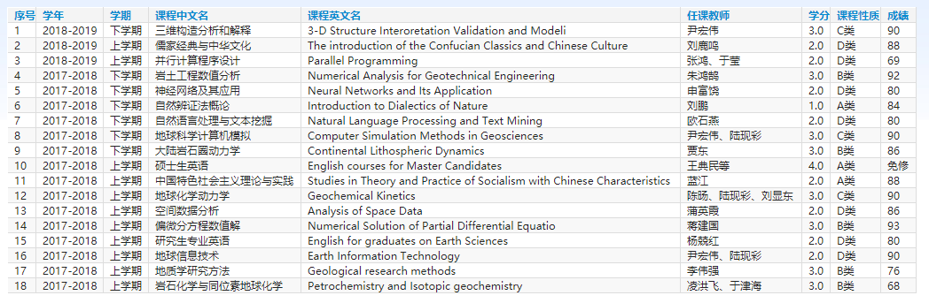
Curriculum
18 courses for 45 credits

Slide 3
Workload
Python Code for Post-processing Algorithm: 56172 lines
2D Compression Structural Experiment: 53 sets
Structural Deformation and Feature Map Figure: 5724 pieces

Slide 4
Thesis
Pages: about 100
Words: about 50k
Repetitive Rate: below 1%

Slide 5
Outline
Introduction
Algorithm
Example
Experiment
Conclusion

Slide 6
Outline
Introduction
Algorithm
Example
Experiment
Conclusion

Slide 7
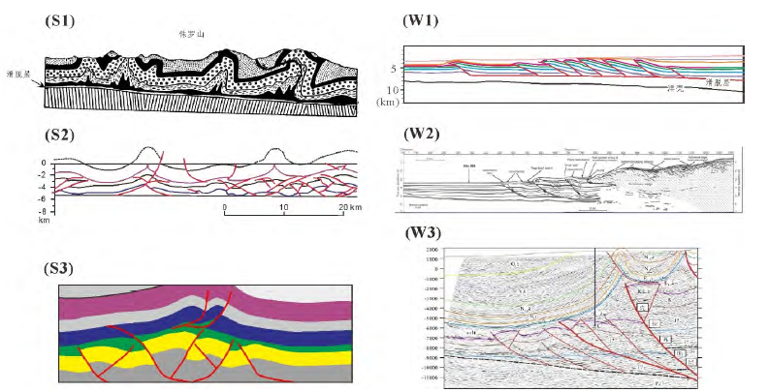
Fold Thrust Belt

Slide 8
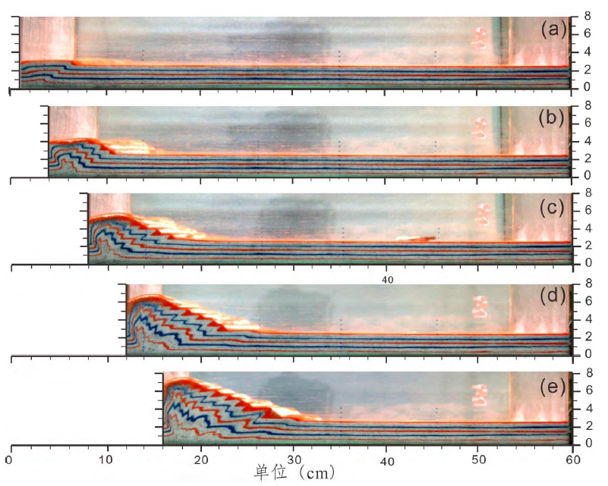
Structural Simulation

Slide 9
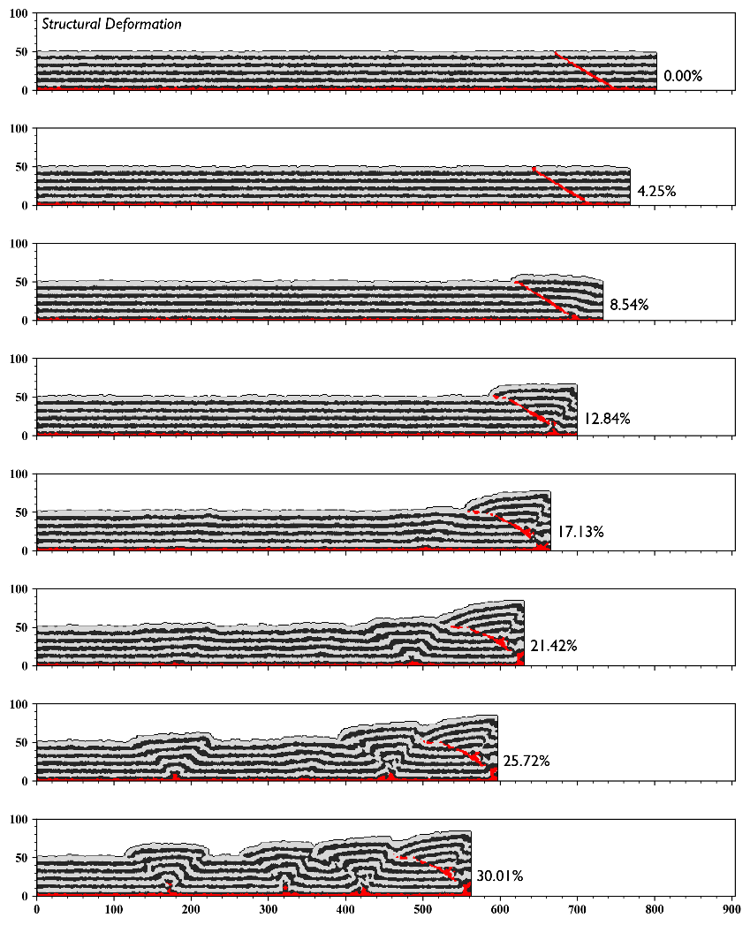
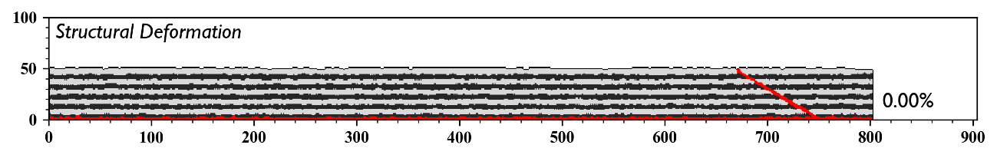
Structural Simulation

Slide 10
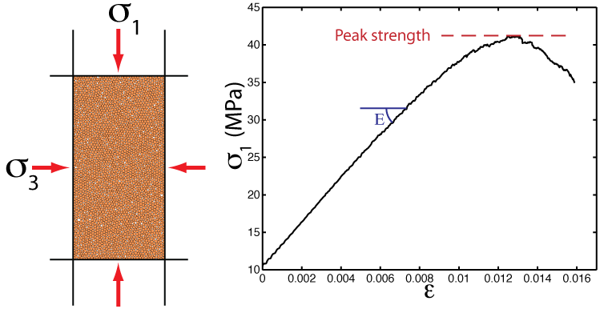
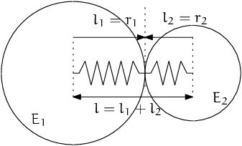
Numerical Simulation
DEM: Discrete Element Model
Micro-granular system for macroscopic object
Based on Newtonian mechanics
Masses of computation

Slide 11
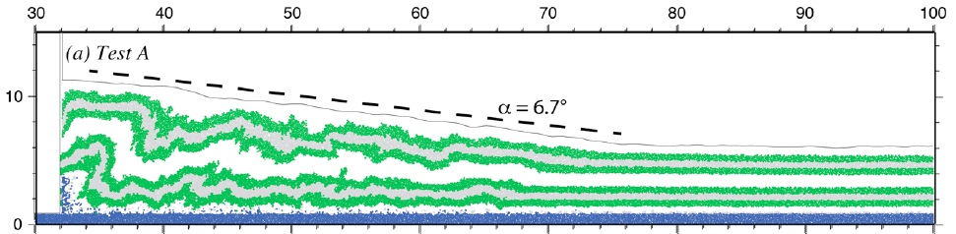
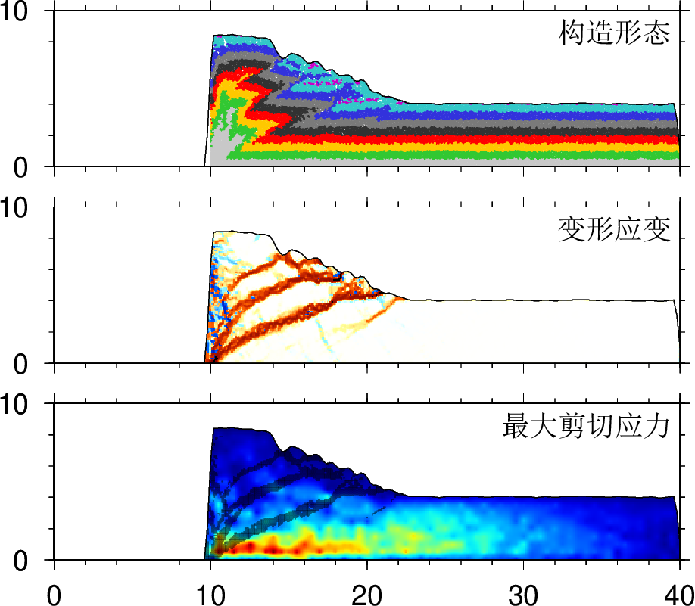
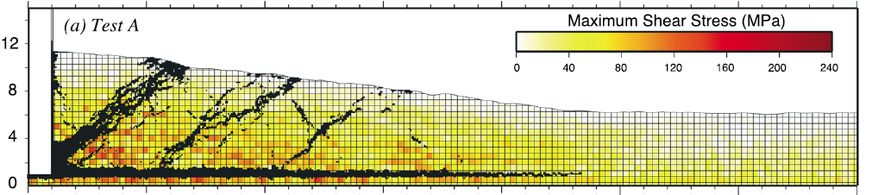
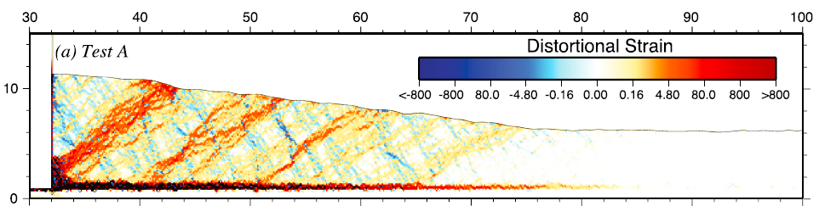
DEM Software

Slide 12
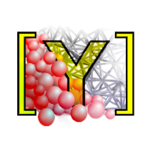
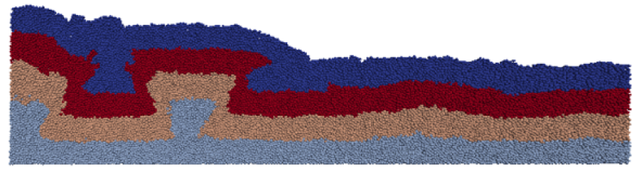
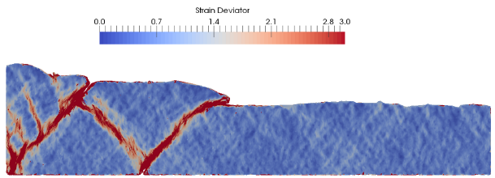
Suitable Software
YADE: Yet Another Dynamic Engine
Performed on Linux
Open Source
Python Command Line

Slide 13
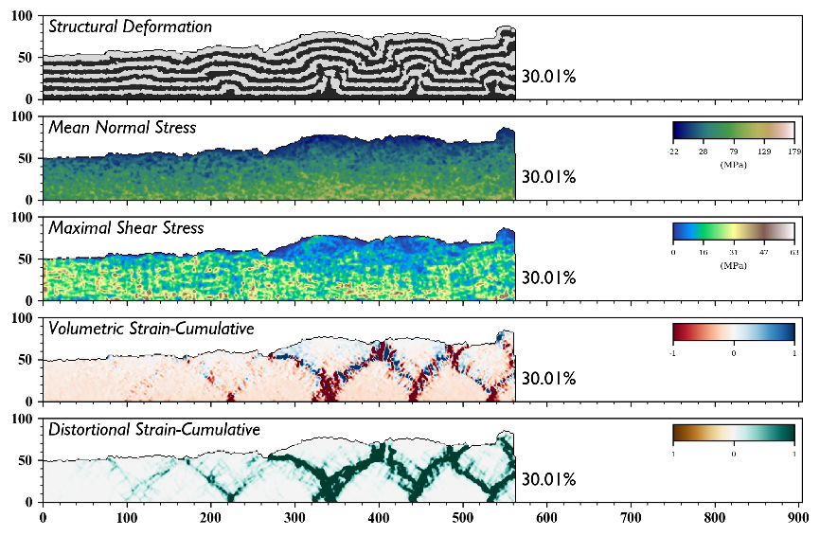
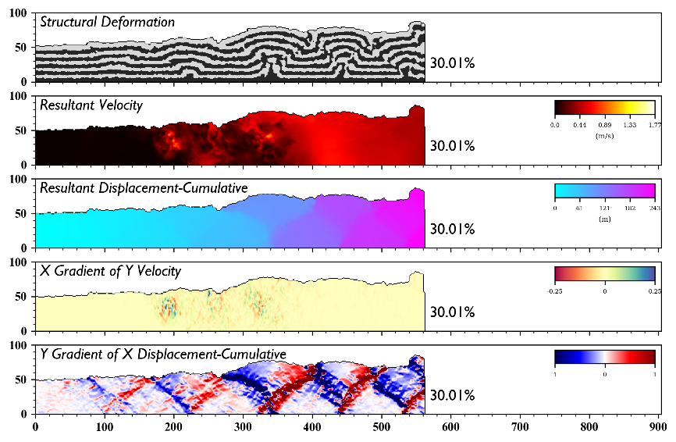
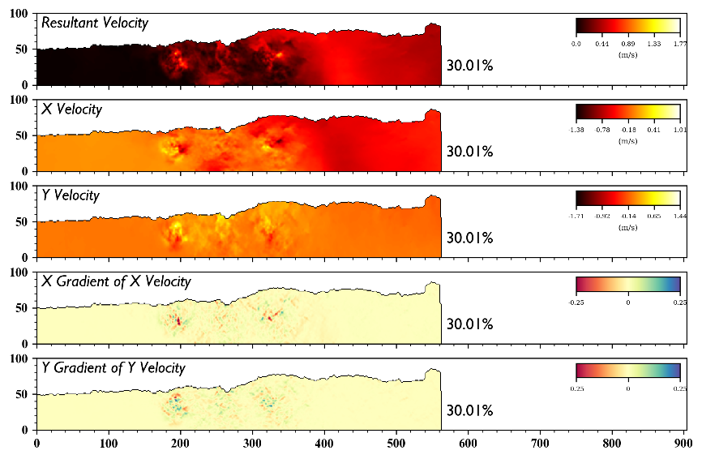
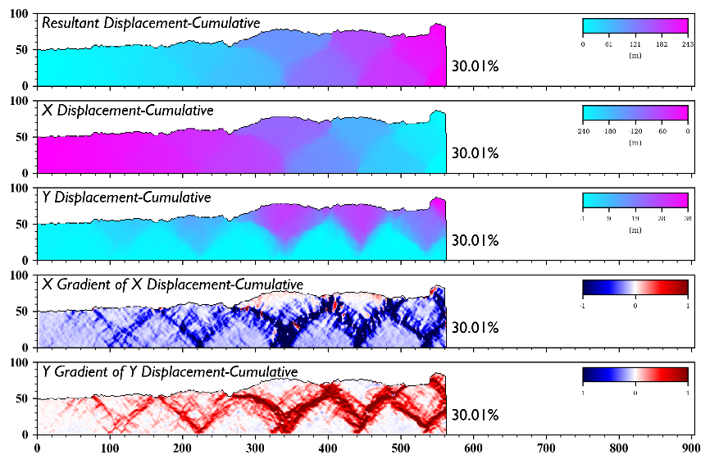
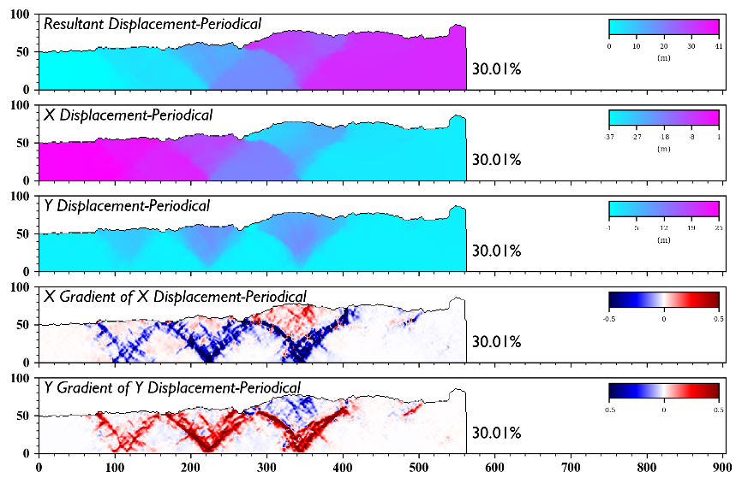
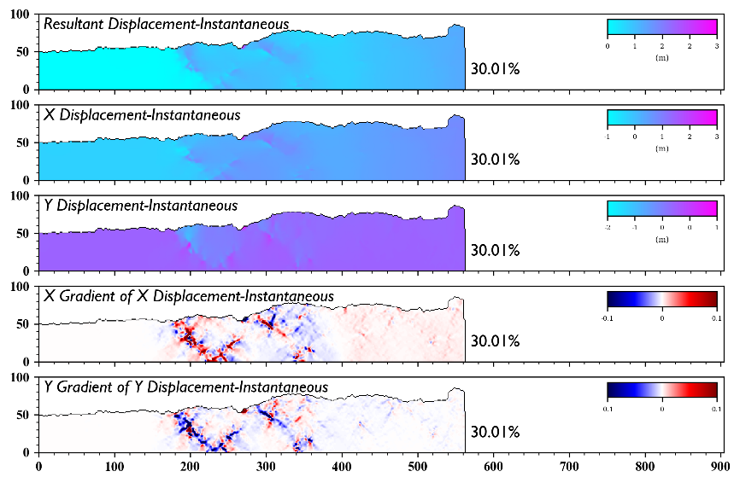
Multi-dimensional Analysis

Slide 14
Outline
Introduction
Algorithm
Example
Experiment
Conclusion

Slide 15

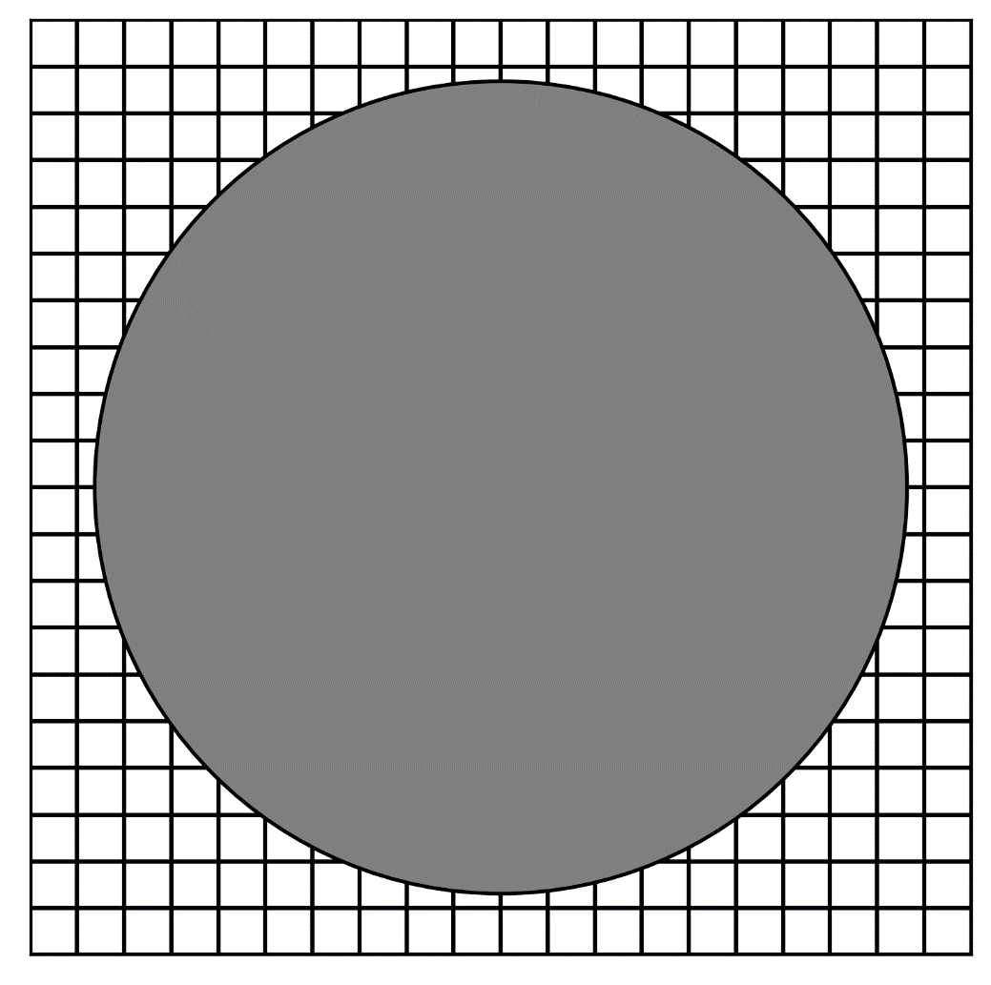
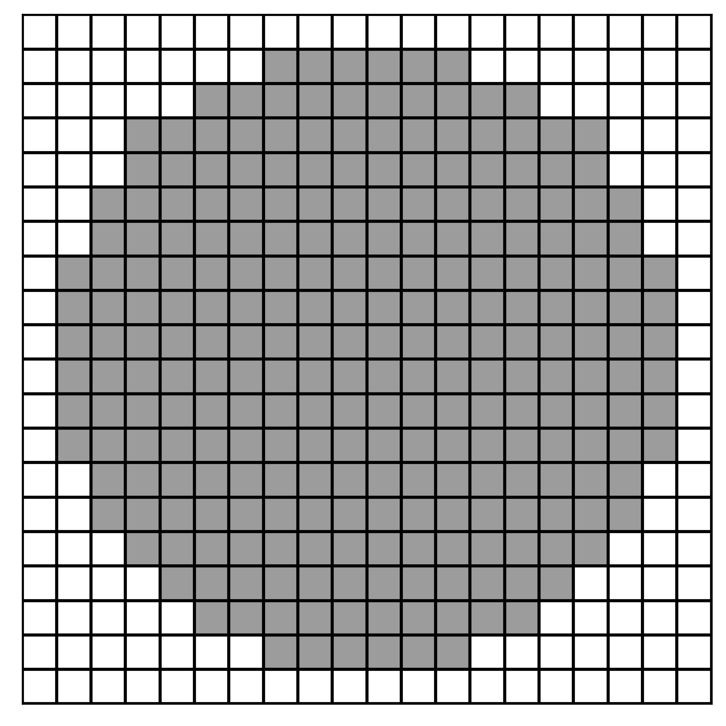


Rasterization
GitHub: https://github.com/jerryweihuajing/Post-Processing

Slide 16
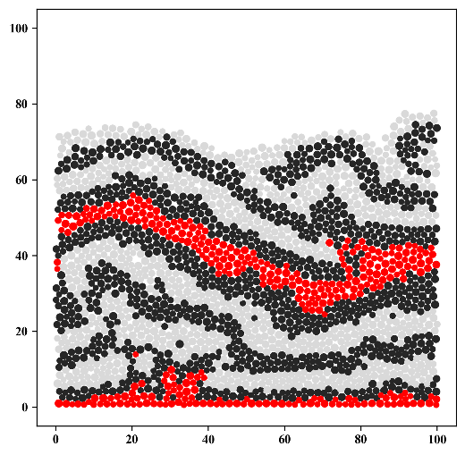
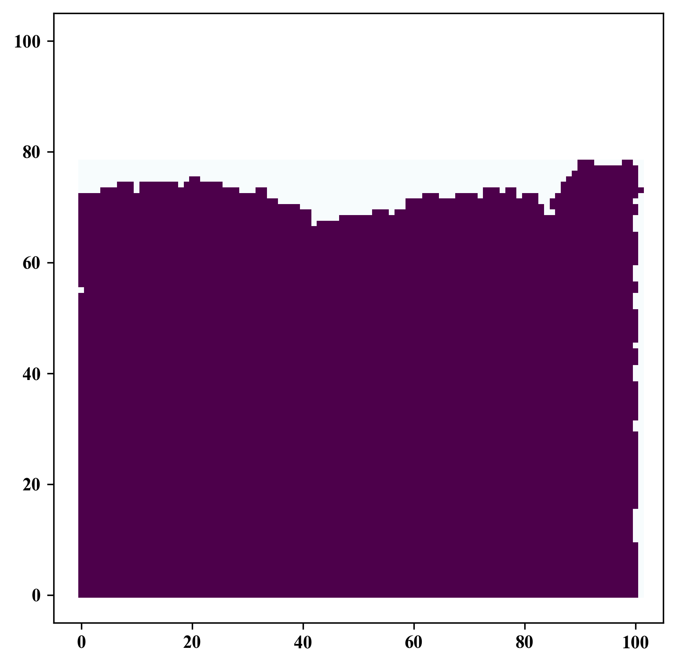
Rasterization
GitHub: https://github.com/jerryweihuajing/Post-Processing

Slide 17
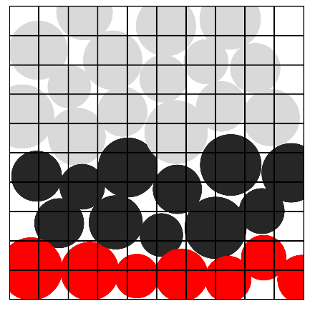
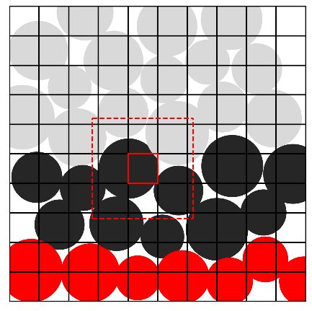
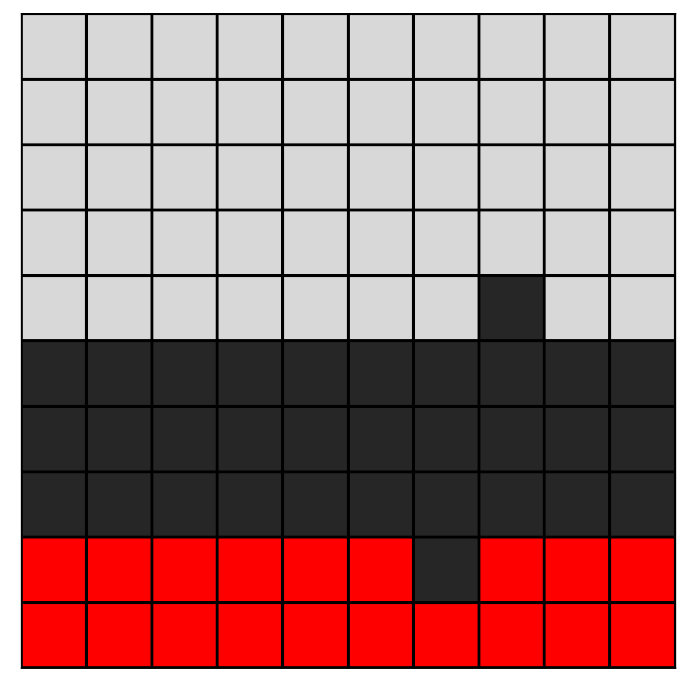
Rasterization
GitHub: https://github.com/jerryweihuajing/Post-Processing

Slide 18

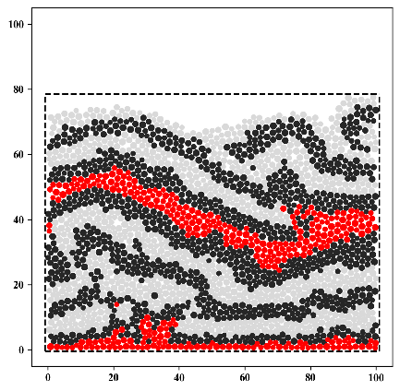
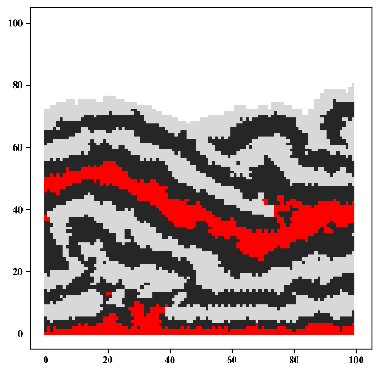
Rasterization
GitHub: https://github.com/jerryweihuajing/Post-Processing

Slide 19
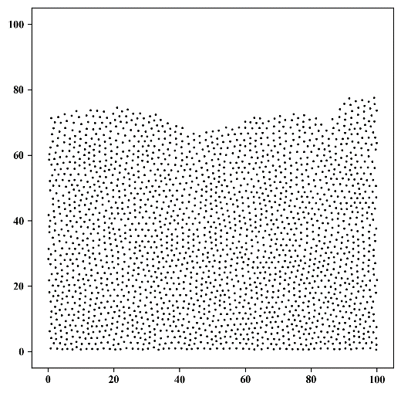
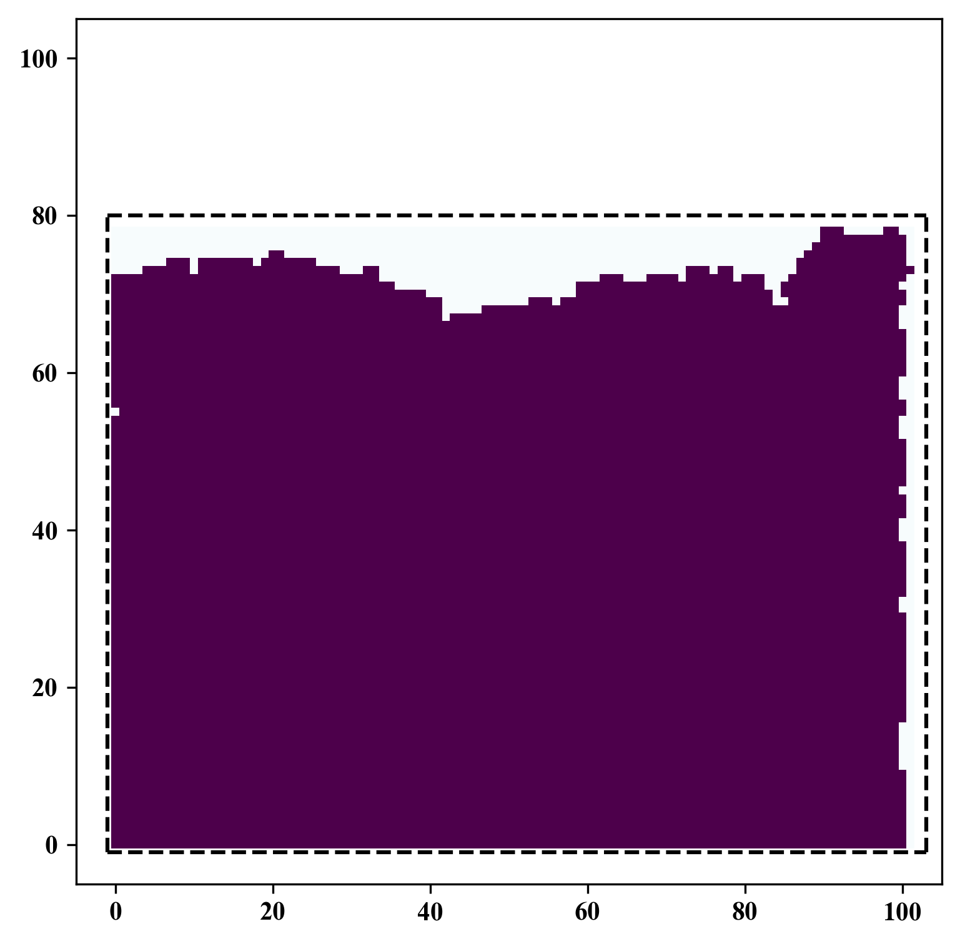
Spatial Interpolation
GitHub: https://github.com/jerryweihuajing/Post-Processing

Slide 20
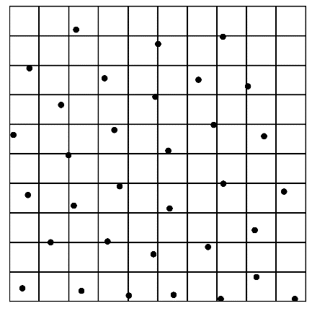
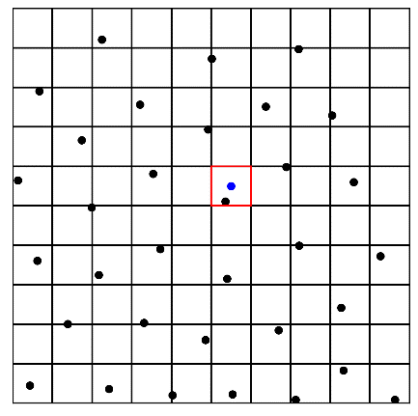
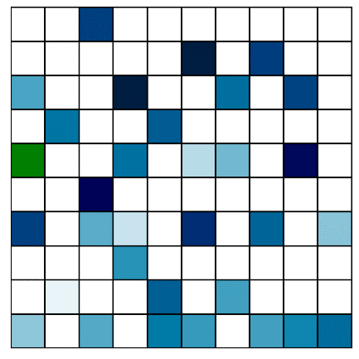
Spatial Interpolation
GitHub: https://github.com/jerryweihuajing/Post-Processing

Slide 21
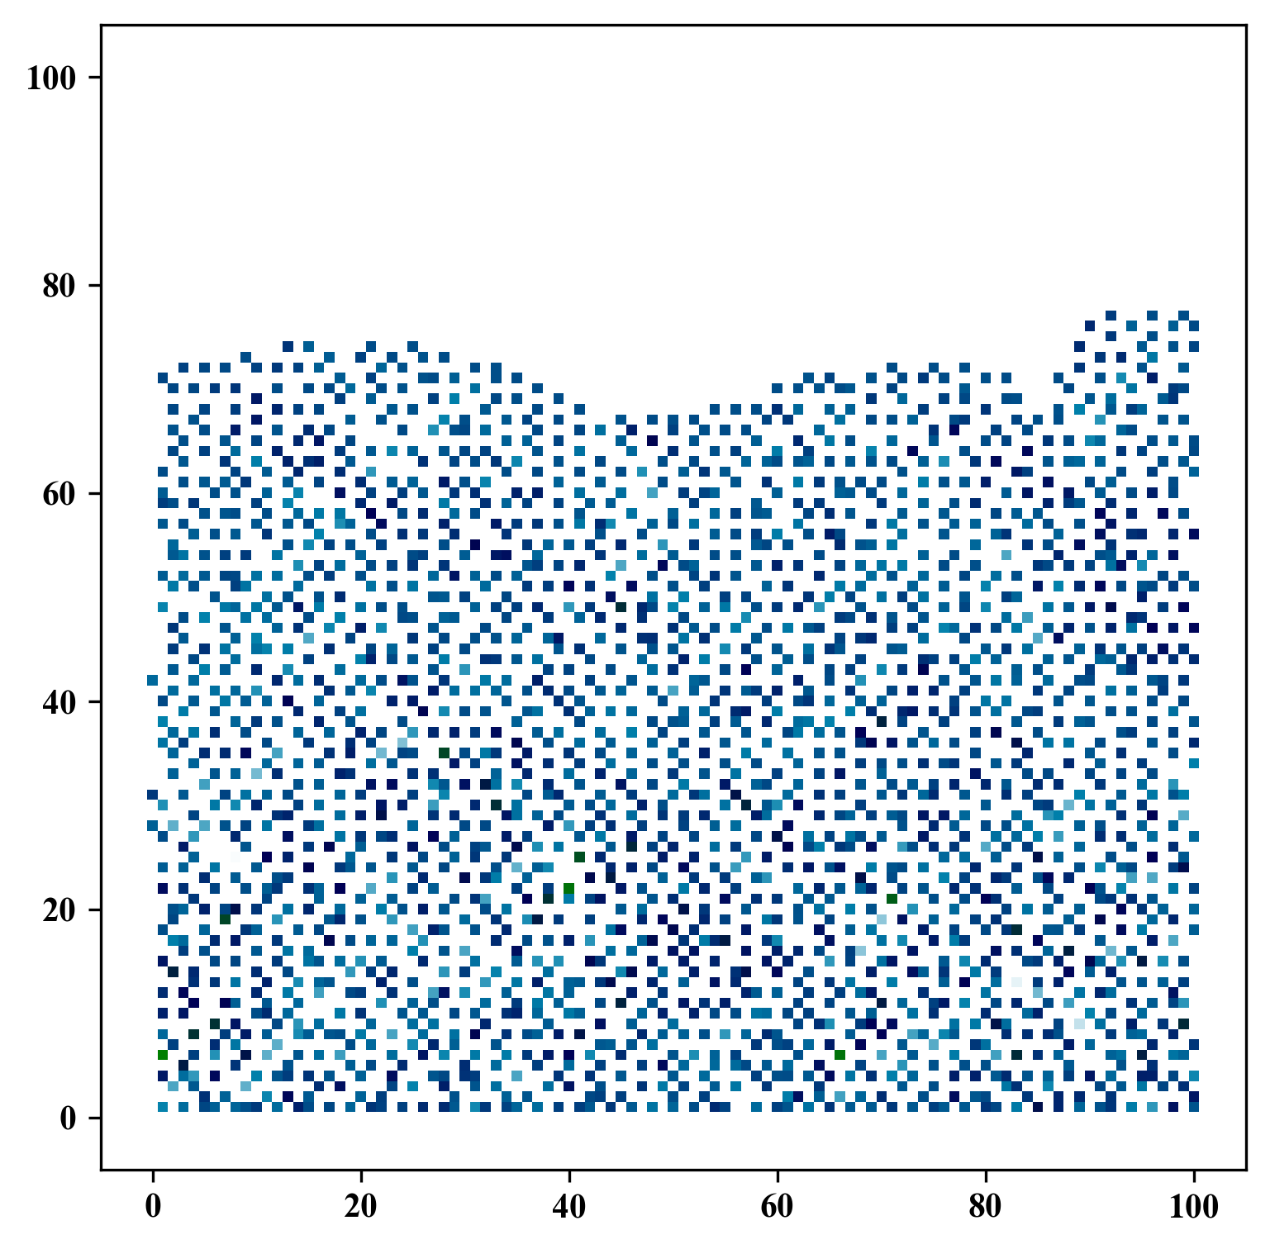
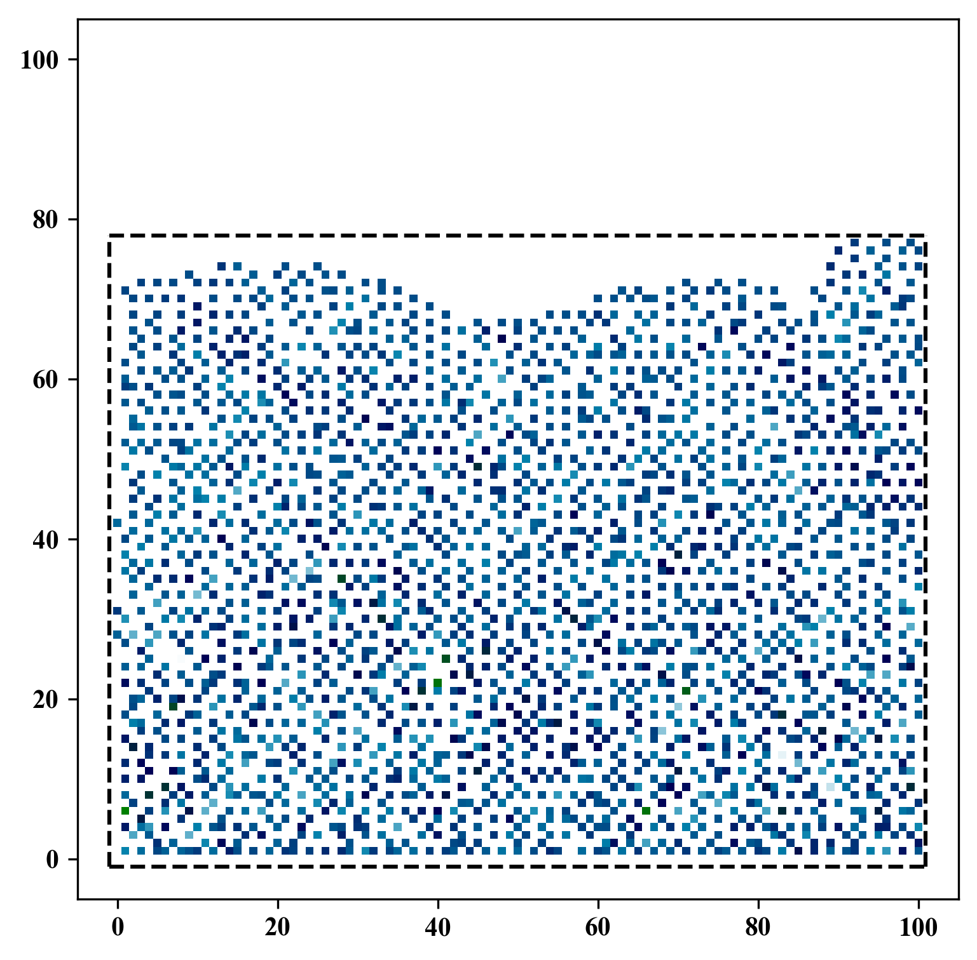
Spatial Interpolation
GitHub: https://github.com/jerryweihuajing/Post-Processing

Slide 22
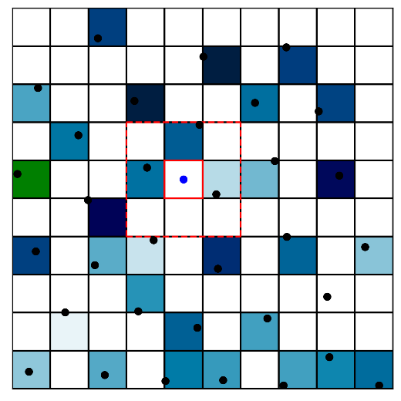
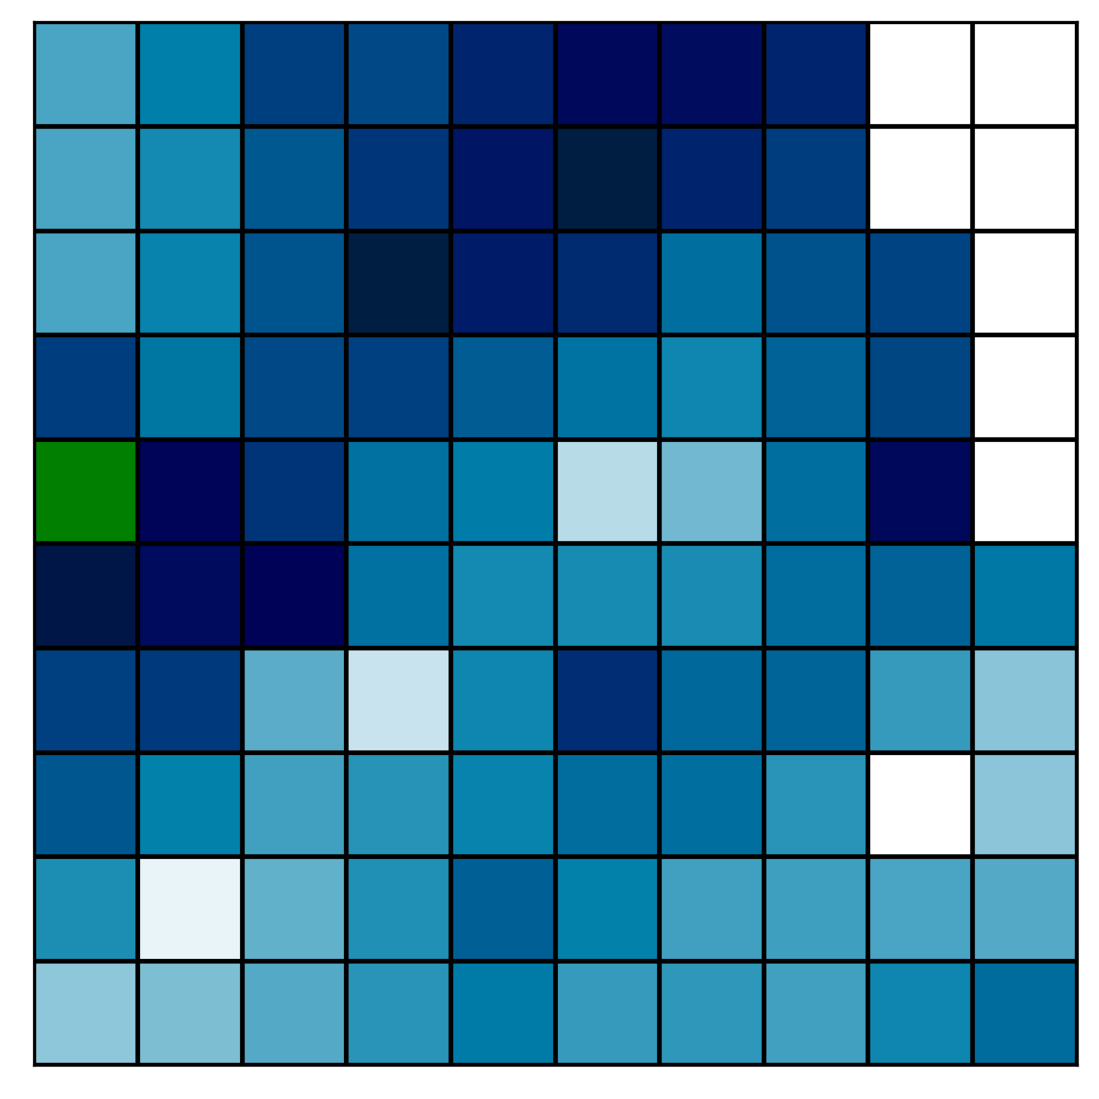
Spatial Interpolation
GitHub: https://github.com/jerryweihuajing/Post-Processing

Slide 23
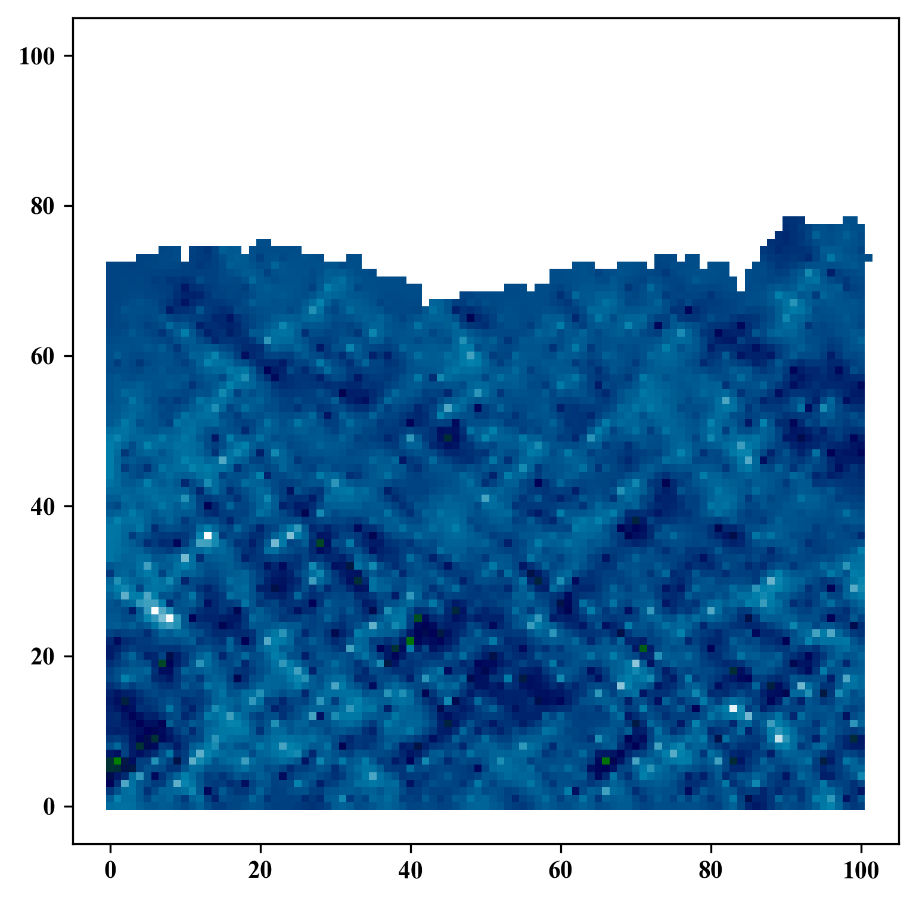
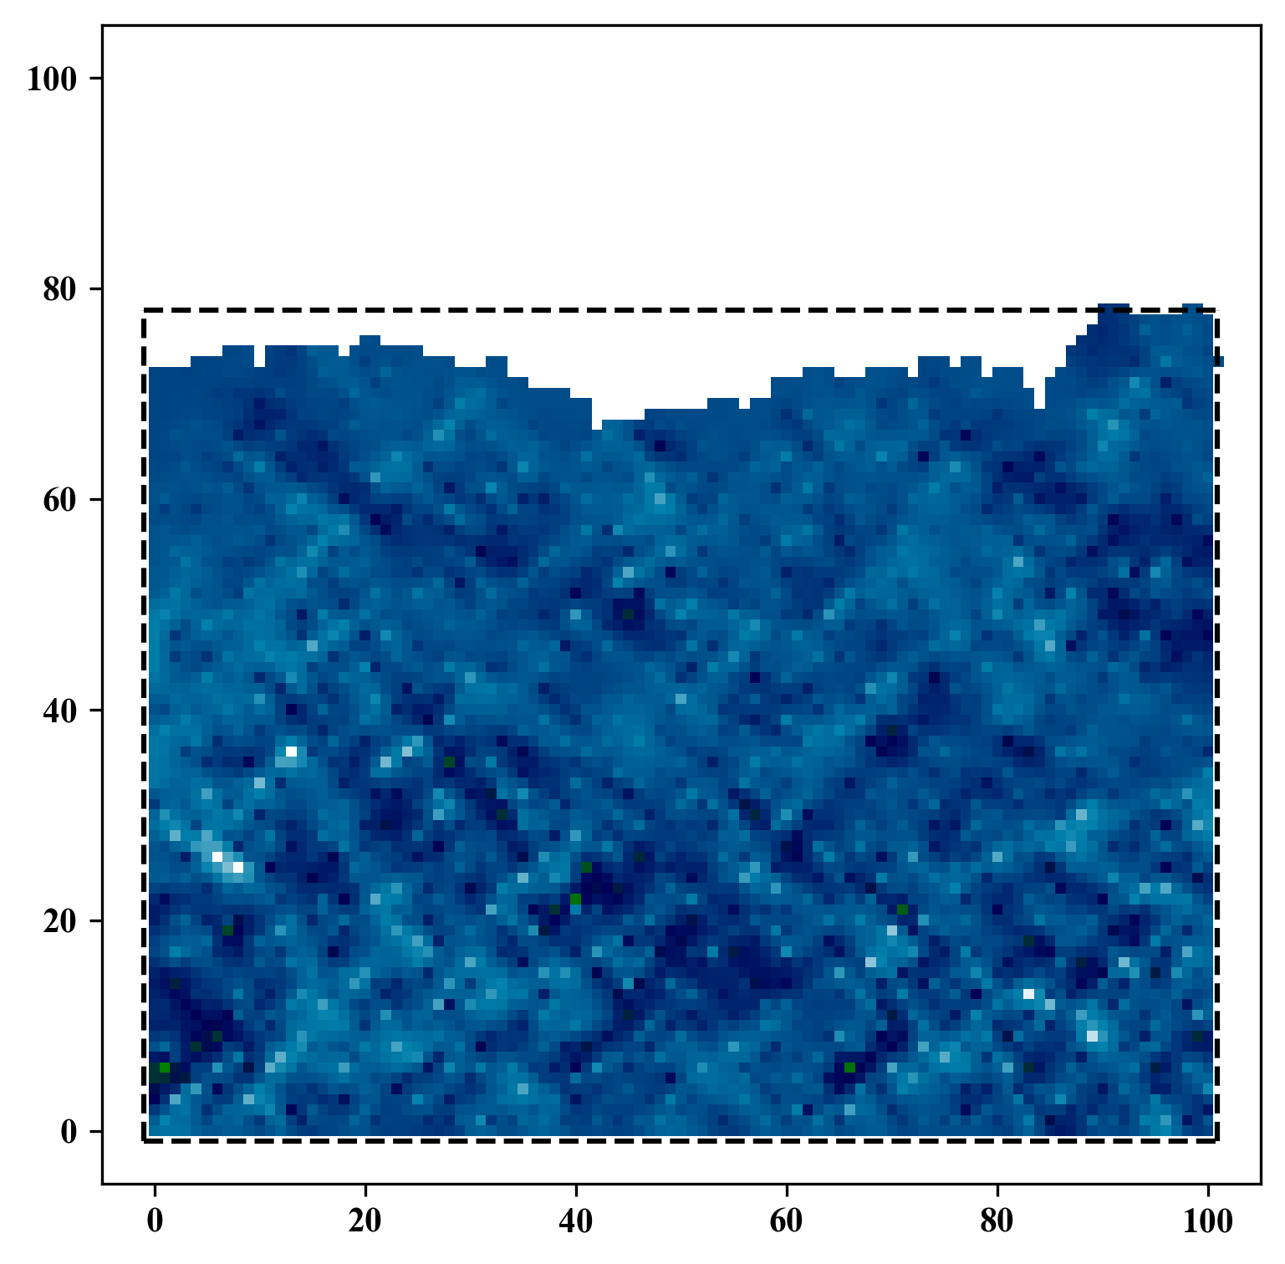
Spatial Interpolation
GitHub: https://github.com/jerryweihuajing/Post-Processing

Slide 24
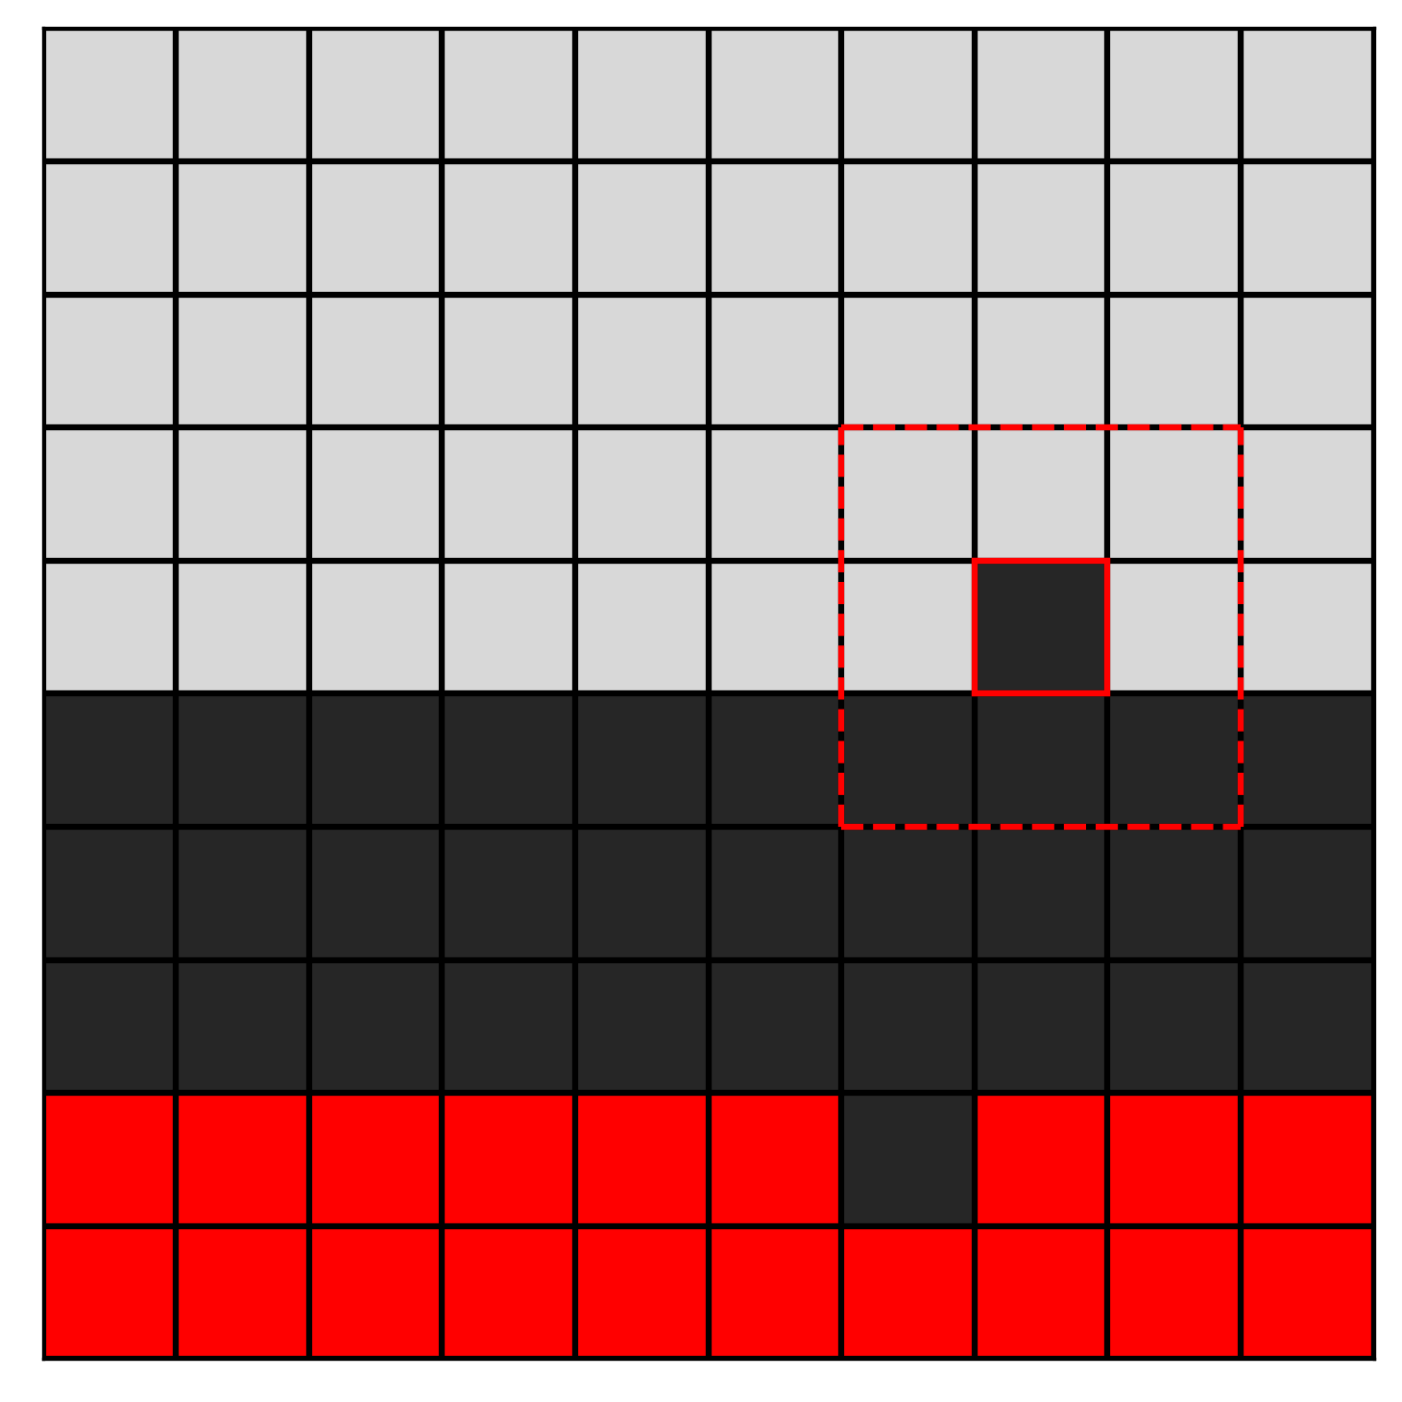
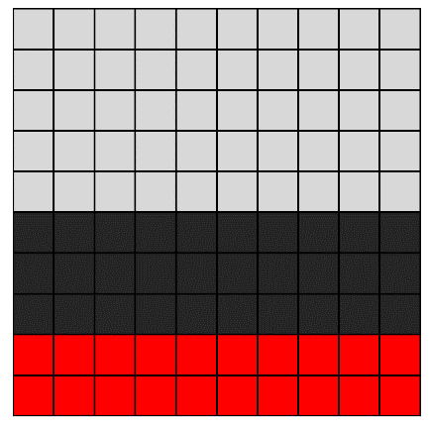
Gaussian Filtering
GitHub: https://github.com/jerryweihuajing/Post-Processing

Slide 25

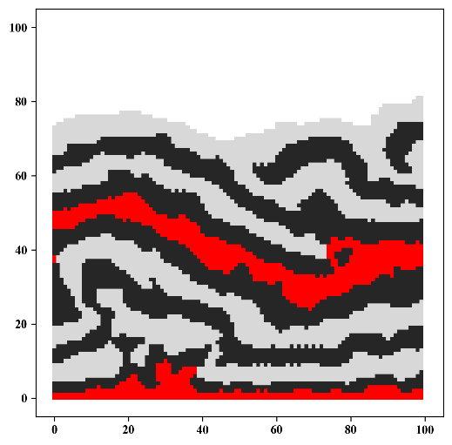
Gaussian Filtering
GitHub: https://github.com/jerryweihuajing/Post-Processing

Slide 26
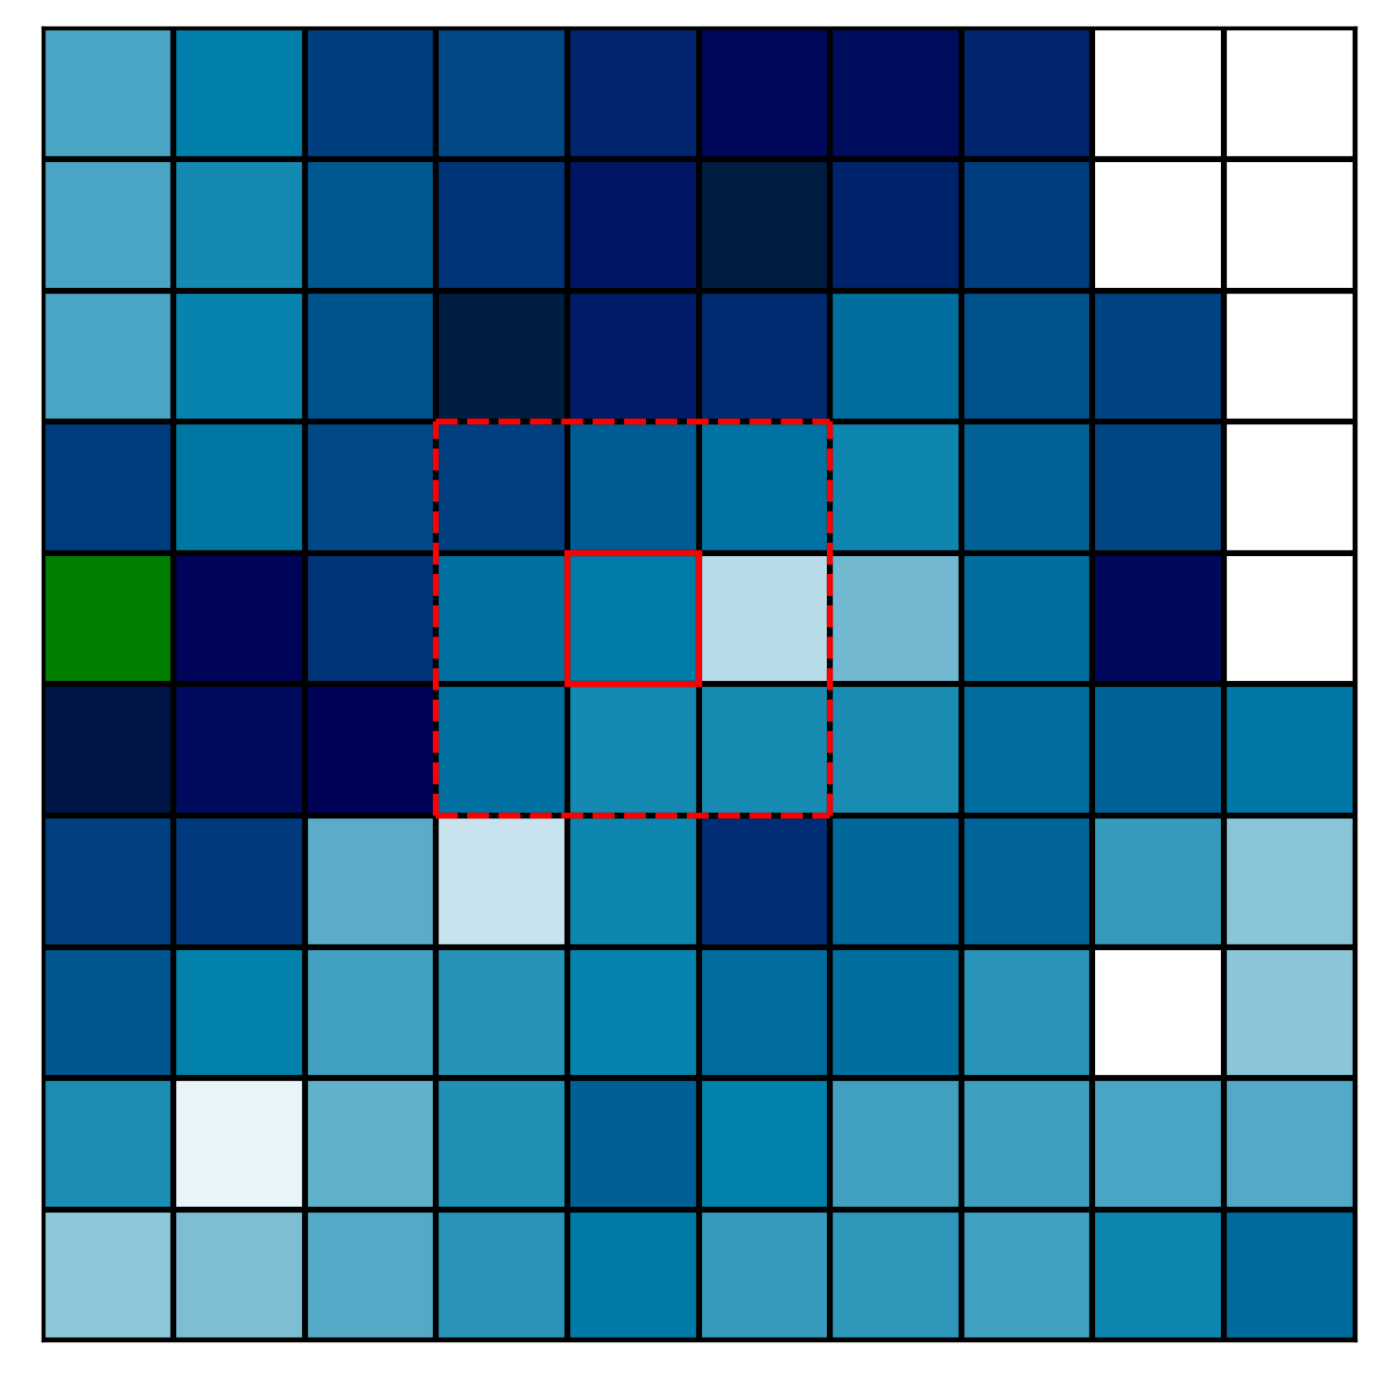
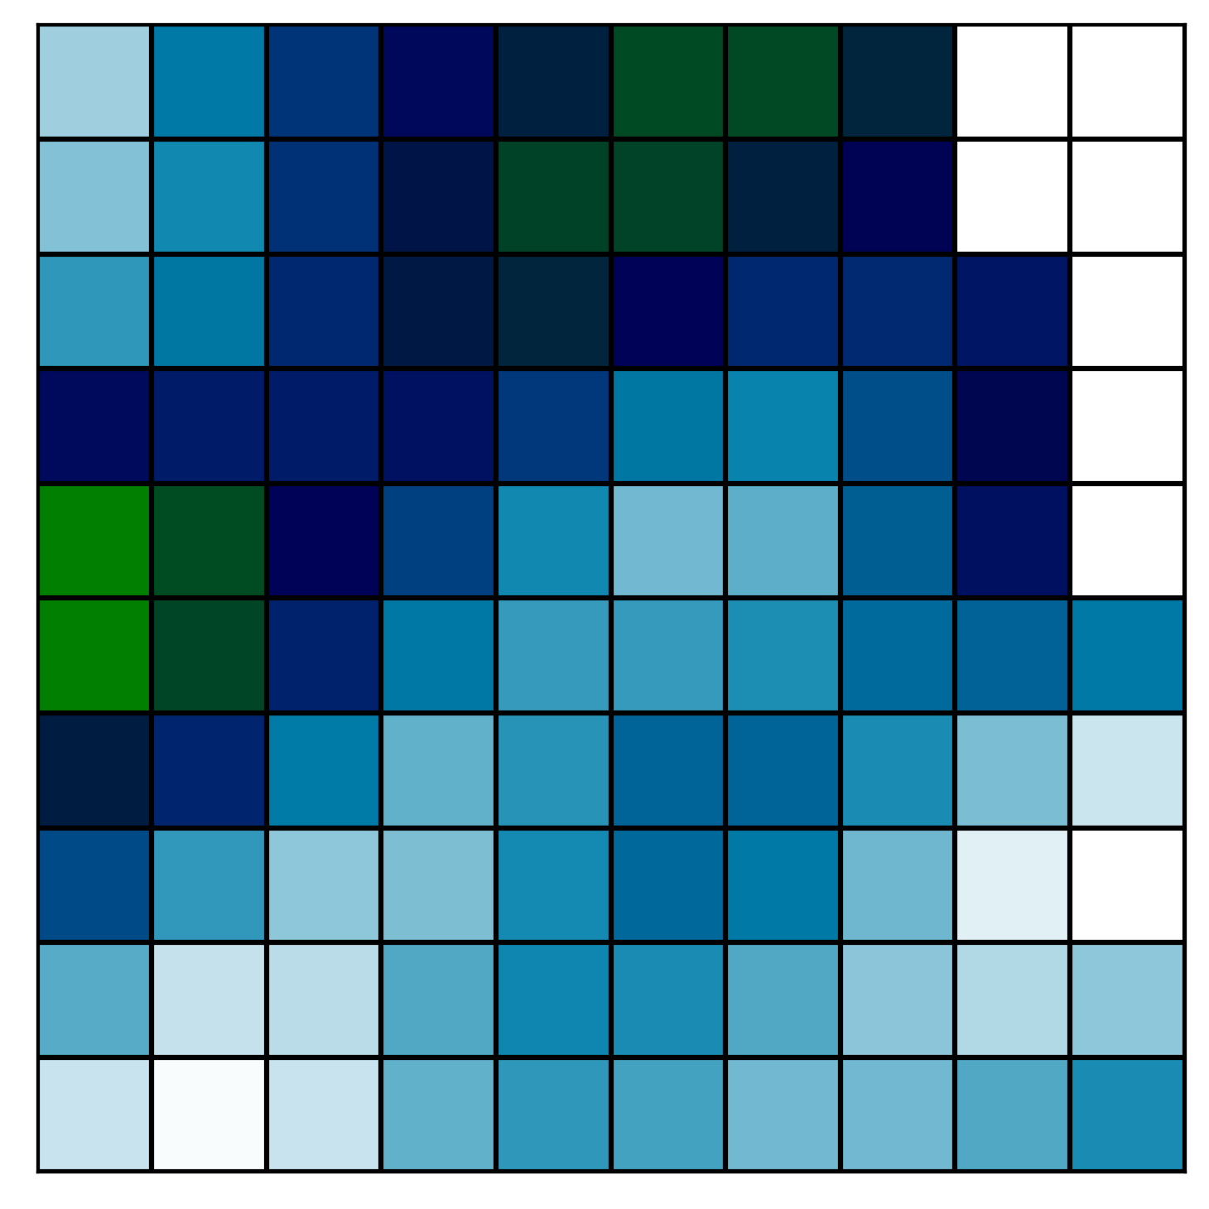
Gaussian Filtering
GitHub: https://github.com/jerryweihuajing/Post-Processing

Slide 27
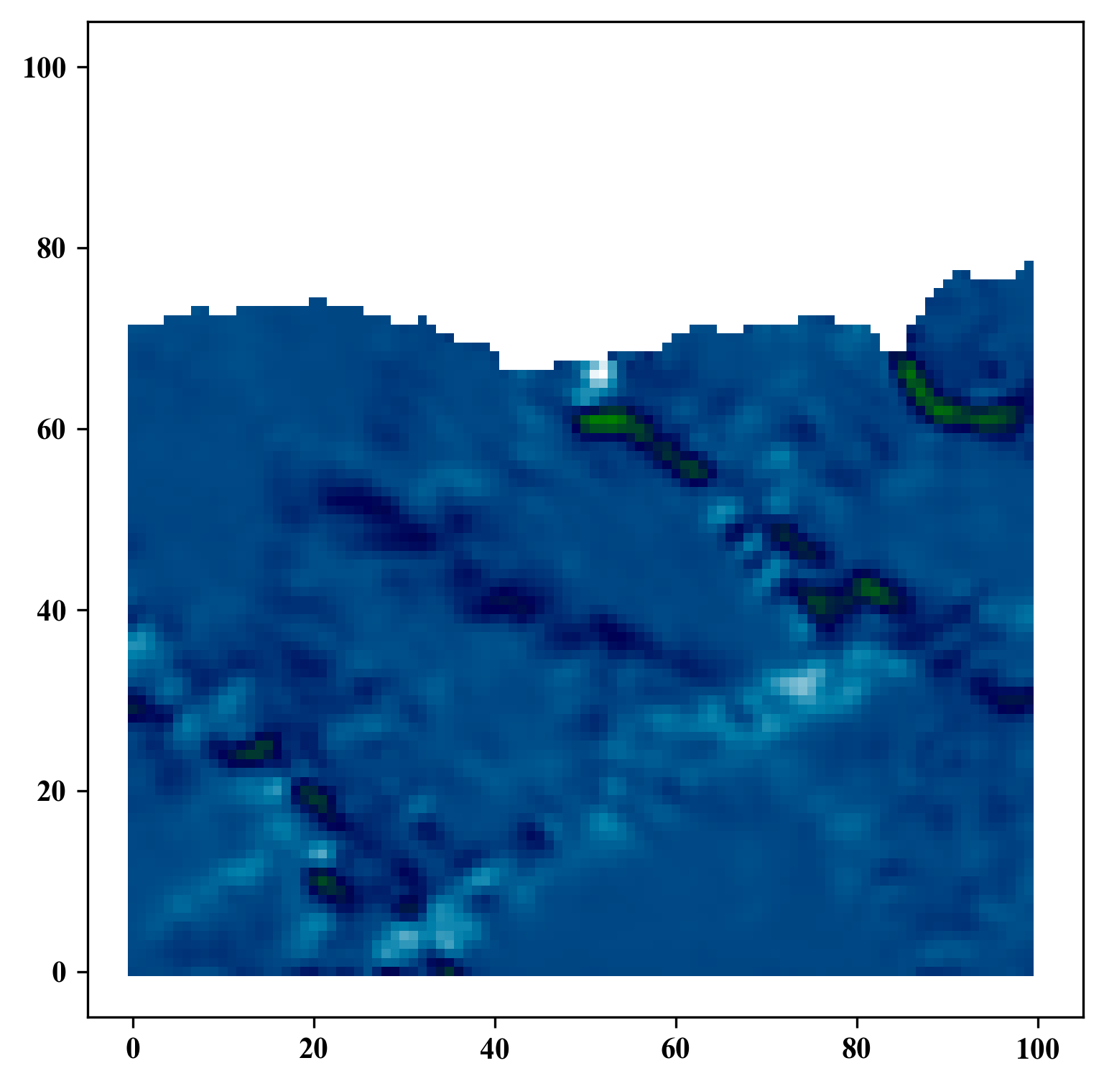
Gaussian Filtering
GitHub: https://github.com/jerryweihuajing/Post-Processing

Slide 28
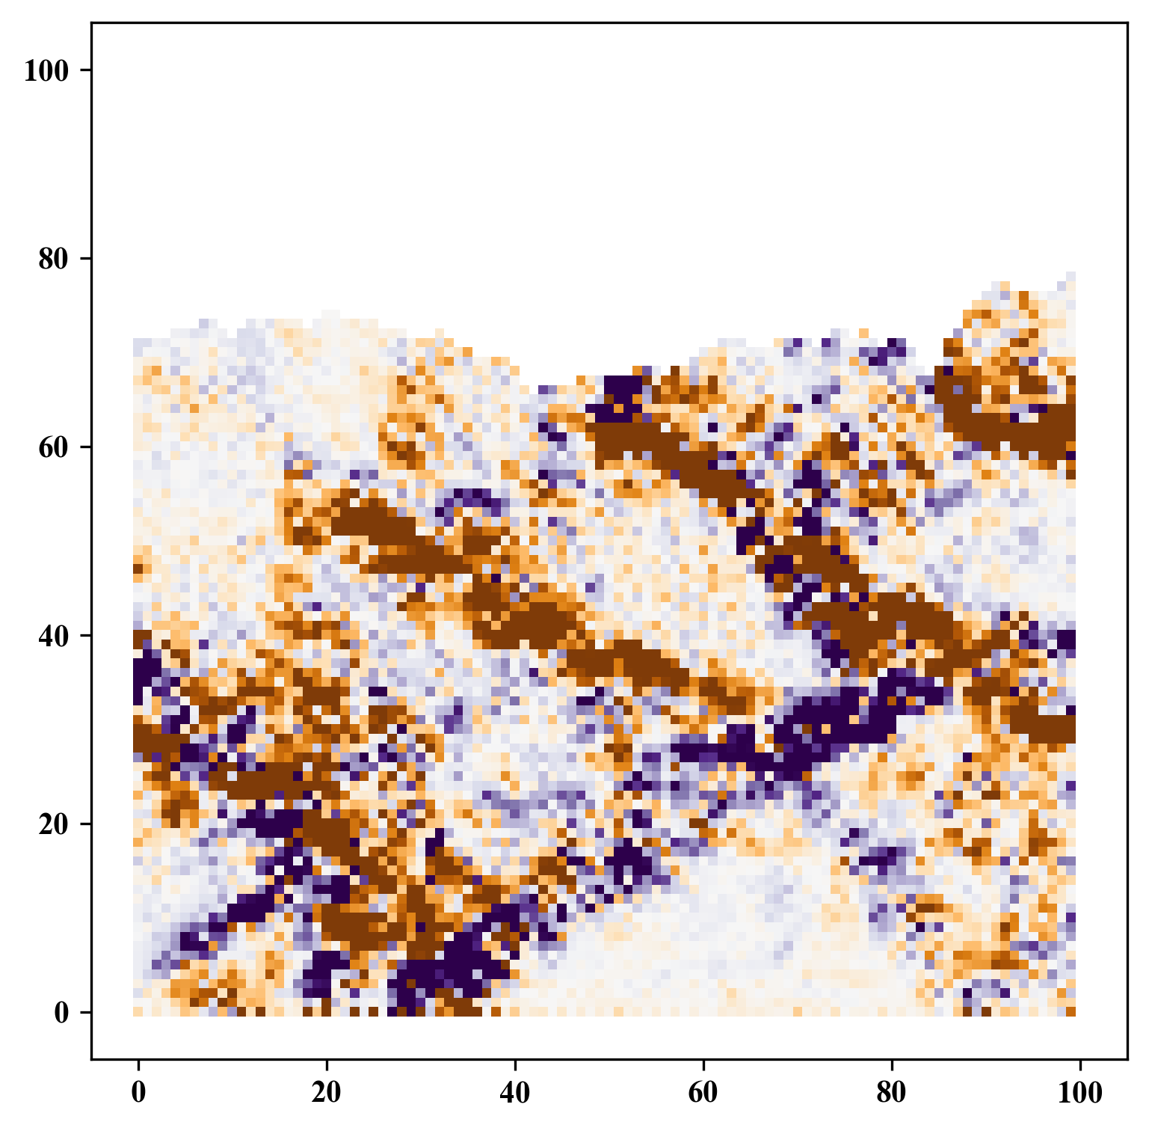
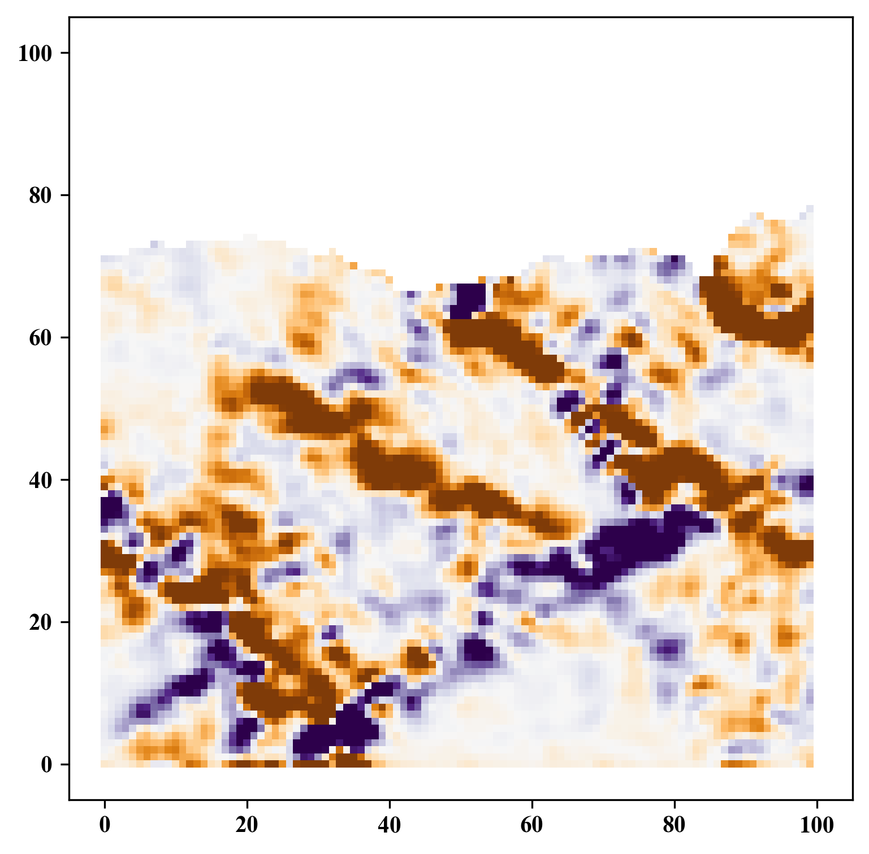
Gaussian Filtering
GitHub: https://github.com/jerryweihuajing/Post-Processing

Slide 29
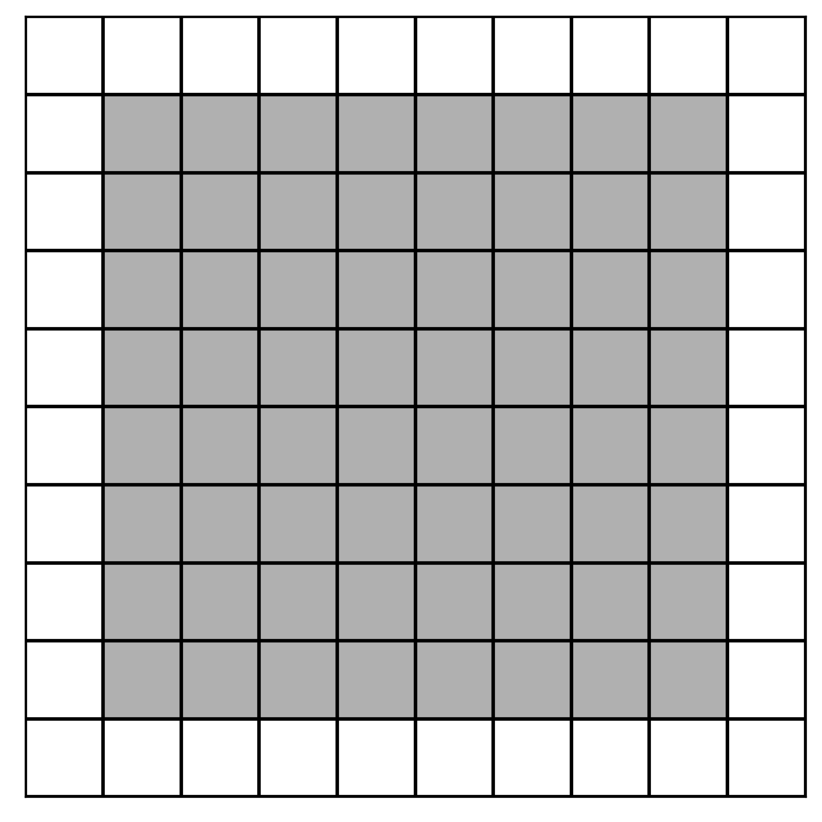
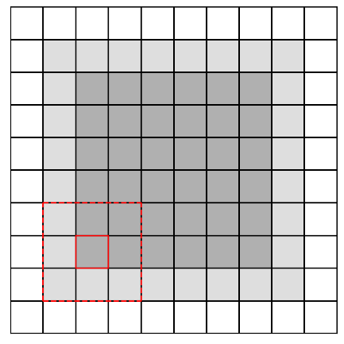

Boundary Extraction
GitHub: https://github.com/jerryweihuajing/Post-Processing

Slide 30



Boundary Extraction
GitHub: https://github.com/jerryweihuajing/Post-Processing

Slide 31

Boundary Extraction
GitHub: https://github.com/jerryweihuajing/Post-Processing

Slide 32

Boundary Extraction
GitHub: https://github.com/jerryweihuajing/Post-Processing

Slide 33

Outline Calculation
GitHub: https://github.com/jerryweihuajing/Post-Processing

Slide 34


Outline Calculation
GitHub: https://github.com/jerryweihuajing/Post-Processing

Slide 35



Outline Calculation
GitHub: https://github.com/jerryweihuajing/Post-Processing

Slide 36

Outline Calculation
GitHub: https://github.com/jerryweihuajing/Post-Processing

Slide 37
Outline
Introduction
Algorithm
Example
Experiment
Conclusion

Slide 38

Model

Slide 39

Structural Deformation

Slide 40


Mean Normal Stress & Maximal Shear Stress

Slide 41



Volumetric Strain

Slide 42



Distortional Strain

Slide 43



Velocity

Slide 44



X Displacement

Slide 45



Y Displacement

Slide 46



Velocity Gradient

Slide 47



X Displacement Gradient

Slide 48



Y Displacement Gradient

Slide 49




Advantages of DEMpost

Slide 50





Advantages of DEMpost

Slide 51




Advantages of DEMpost

Slide 52
Outline
Introduction
Algorithm
Example
Experiment
Conclusion

Slide 53


Salt

Slide 54


Salt Thickness

Slide 55


Salt Thickness

Slide 56




Salt Width

Slide 57




Salt(far away) Width

Slide 58




Salt Depth

Slide 59




Salt Offset

Slide 60




Fracture Orientation

Slide 61




Fracture Inclination(+)

Slide 62




Fracture Inclination(-)

Slide 63




Fracture Depth(+)

Slide 64




Fracture Depth(-)

Slide 65


Fracture Offset(+)

Slide 66


Fracture Offset(+)

Slide 67


Fracture Offset(-)

Slide 68


Fracture Offset(-)

Slide 69




Fracture Scale-from Bottom(+)

Slide 70




Fracture Scale-from Bottom(-)

Slide 71




Fracture Scale-from Surface(+)

Slide 72




Fracture Scale-from Surface(-)

Slide 73
Outline
Introduction
Algorithm
Example
Experiment
Conclusion

Slide 74
Conclusion
Multi-dimensional Analysis: Necessary for structural simulation research.
DEMpost: A friendly and efficient DEM post-processing module.
Single Salt Layer: Shrinkage and box-shape structure.
Double Salt Layer: Soften the strata nearby and stable condition inside the salt.
Pre-existing Fracture: Promote the upper plate to move upwards along the fracture.

Slide 75
Acknowledgement
THANKS

